Slide 1
iSKKUBot
RAG-based Multilingual Chatbot for Exchange Students at SKKU
Notes:
This is jiae in team H, and we are developing iSKKUBot, a RAG-based Multilingual Chatbot for Exchange Students at SKKU.

Slide 2

EQUIPO SASHIMI
GeonWoo Bang
JungYoon Hwang
Jiae Choi
Mikel Larrarte Rodriguez
Notes:
this is our team EQUIPO SASHIMI.

Slide 3
Table of contents.
1
Progress & Role
What have we done & role assignment
2
Performance and Efficiency Improvement
What we did to improve our model’s performance and efficiency
3
Hallucinations and Recent data
Trials to solve RAG’s main challenges
4
Evaluation Dataset
Eval dataset to evaluate our model
5
Front end
Build our chatbot UI
Notes:
Today's presentation will cover the following topics.

Slide 4
Progress & Role
1
What have we done & role assignment
Notes:
This is what have we done and our role assignment

Slide 5
Timeline
 | Week 6 | Week 7 | Week 8 | Week 9 | Week 10 | Week 11 | Week 12 | Week 13 | Week 14 | Week 15
Scrap form Web/PDF |  |  |  | done
Construct Database |  |  |  | done
Implement RAG(Retriever) |  |  |  | done
Implement RAG(Generator) |  |  |  | done
Evaluate
Implement Back-end |  |  |  |  |  | In progress
Implement Front-end |  |  |  |  |  | In progress
Notes:
The current timeline is as follows.
today is week 9, we finished scrap from web, pdf and constructing external database.
Actually, we finished scraping data and constructing database in week7, but there were some problems. So in week 8 and 9 we did additional works. I’ll talk about that in next slides.
We’ve been working hard on implementing RAG, retriever part is almost done and generator part is partially completed.
We’ve also started working on the front-end part.

Slide 6
Roles
Jiae: Front-end + Improve database quality.
GeonWoo: Back-end (API) + Improve efficiency.
JungYoon: Improve database quality + New features (Link providing, database update).
Mikel: Generation of evaluation dataset + Research models for evaluation.
Notes:
Jungyoon and I took a part in indexing and front-end, Mikel and 건우 have divided the tasks of implementing RAG and evaluation.

Slide 7
Performance & Efficiency
2
What we did to improve our model’s performance and efficiency
Notes:
Now, let's review what we have implemented so far.

Slide 8
Performance
Problem: Performance of RAG is highly dependent on the retrieving process.
Dataset quality
Retriever quality
Notes:
Performance of RAG is highly dependent on the retrieving process.
To enhance the performance, we tried to improve the dataset and retriever quality.

Slide 9
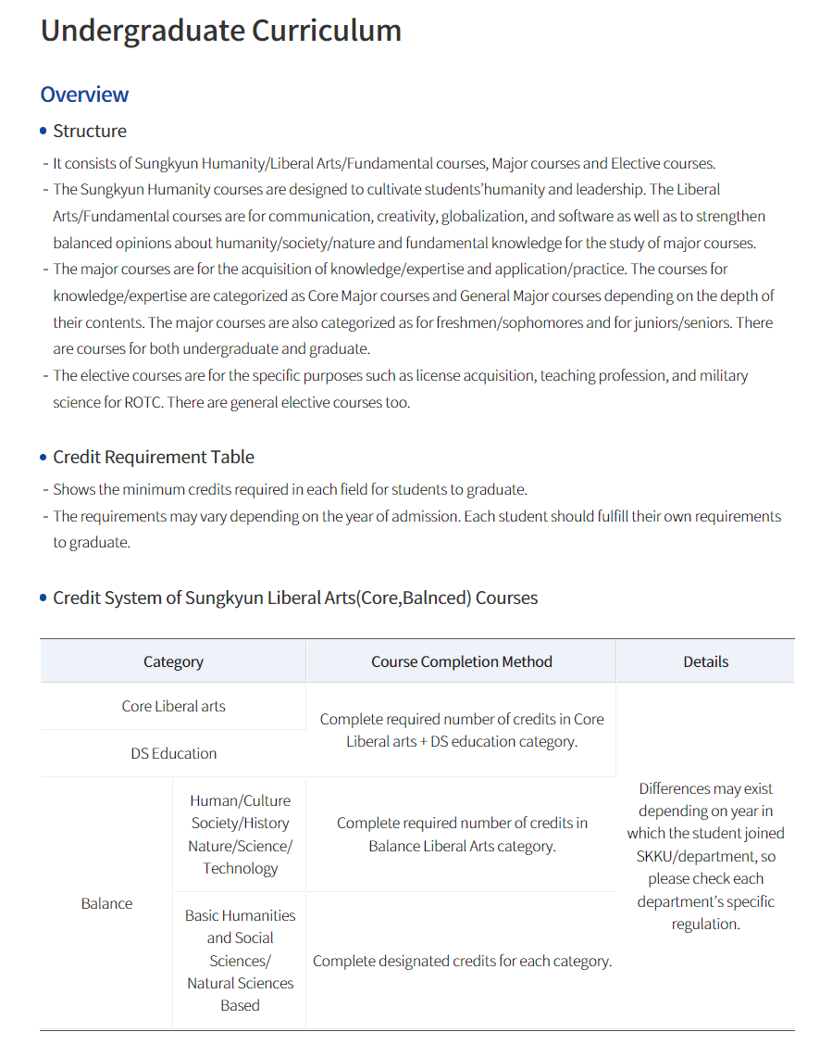
Performance
Dataset Quality
Before: Created chucks to embed based on the text length
-> Each chuck does not contain coherent information
Notes:
The problem with the current way to create chucks is that each chuck does not contain coherent information because they are divided based on sequence length.

Slide 10
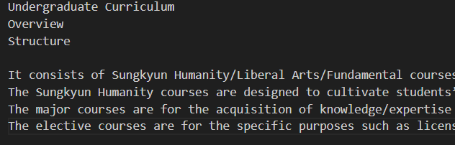
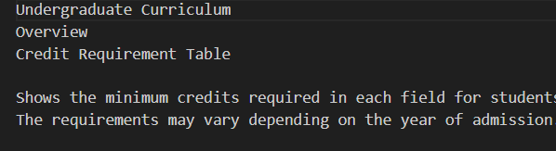
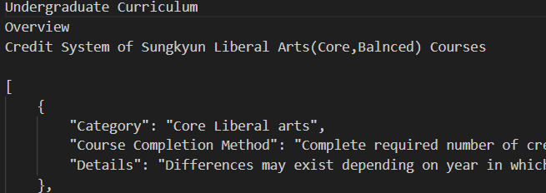
Performance
Dataset Quality
After: Created chucks based on headers, with each chuck having the title of the page and the corresponding header so that the retriever can identify what each chuck is about more clearly
Notes:
To mitigate this problem, we divided chucks based on headers in the page.
And also made each chuck to contain title, header, subheader, so that the retriever can identify what each chuck is about more clearly

Slide 11
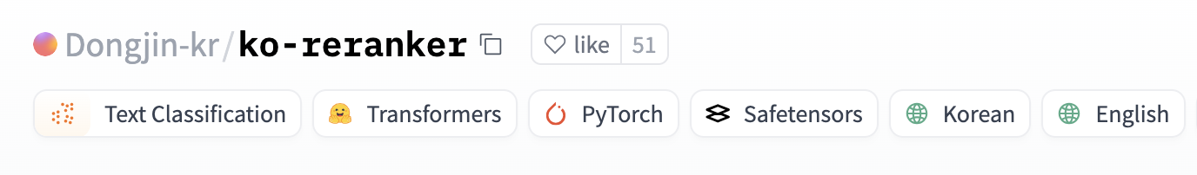
Performance
Problem: Default RAG has low retrieve Quality
Direct use of the query as-is leads to poor search quality and limited comprehension of complex contexts.
We used ReRanker to implement Advanced RAG

Slide 12
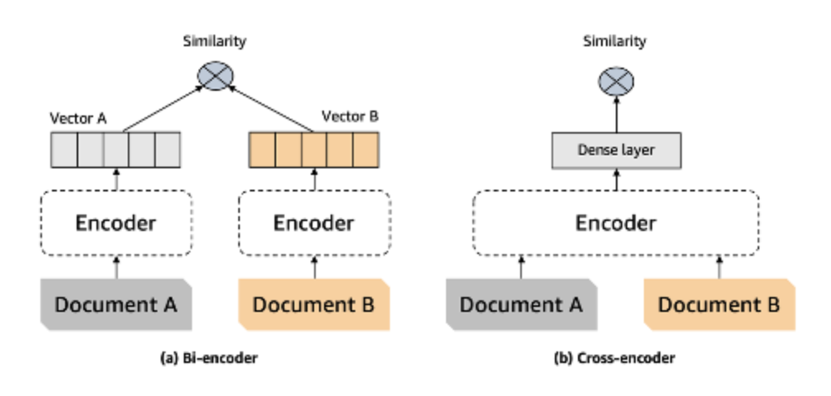
Performance
ReRanker
Use Cross-encoder for context retrieve.
Used for final top-k similarity verification from the original retriever to minimize time consumption.

Slide 13
Performance
Top 1 context compare
Query: how can i find my classroom?
Original RAG: [’(’Humanities and Social Sciences Campus’, ‘= 02) 760-1299’): Location: Dasan Hall of Economics 3 floor 32327, (‘Natural Sciences Campus’, ‘= 031) 290-5682’): Location: Shops & Services Center 3" floor’] -> Not that relevant top 1
RAG with ReRanker:[‘323 강의실 찾는 방법 강의실 번호로 강의실 찾는 방법 예) 강의실 번호가 90212일 경우 90은 건물번호, 2는 층수, 12는 방 번호이므로, 90212호는 국제관 2층에 있는 212호입니다. 인문사회과학캠퍼스 주요 건물 번호 - 10XXX: 600주년기념관 - 20XXX: 법학관 - 31XXX: 퇴계인문관 - 32XXX: 다산경제관 - 33XXX: 경영관- 50XXX: 호암관 - 61XXX: 수선관 - 62XXX: 수선관별관 - 90XXX: 국제관… ‘] -> more accurate top 1

Slide 14
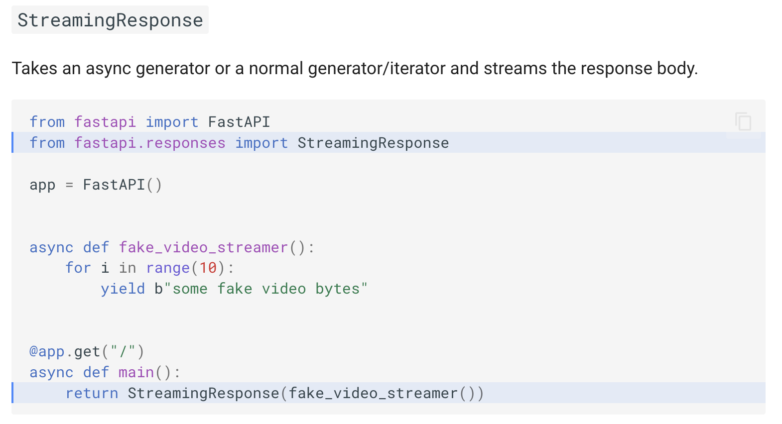
Efficiency
Problem: Response time is too long.
Slower response due to output after complete generation.
-> Decided to use Async method on FastAPI

Slide 15

Efficiency
Per-token output greatly reduces perceived response time.

Slide 16




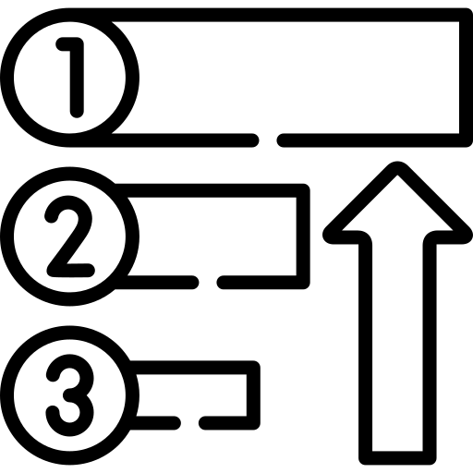


Backend Development
Query
Deploy
Embedder
Stream Response
ReRanker
EEVE LLM
Prompt Engineering
pull
Async Response
Ollama
iSKKU-Bot API

Slide 17
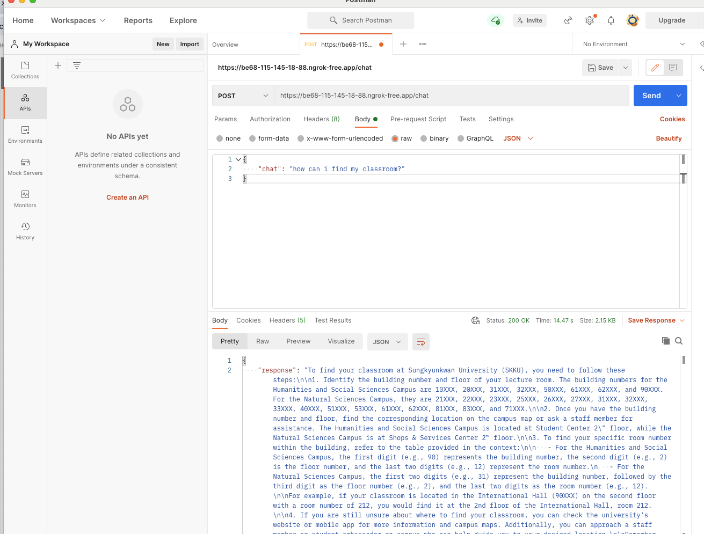
Backend Development
Post Check via Postman.

Slide 18
Hallucinations & Recent data
3
Trials to solve RAG’s main challenges
Notes:
The main challenges with RAG are hallucination and the ability to retrieve recent data.

Slide 19
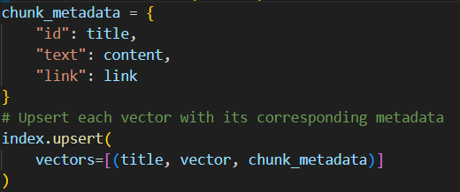
Hallucinations
Provides links to the original webpage that the RAG used to generate answers
Notes:
To mitigate hallucinations to some degree, we plan to provide links to the original web page together with generated answers.
In doing so, the user can double check on the provided information by visiting the original source.

Slide 20
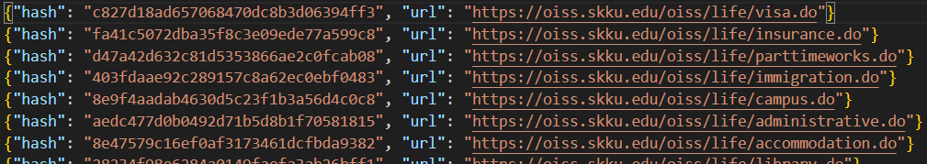
Recent data
Scrap webpage that has been modified
‘Last-Modified’ HTTP header
Not all webpage include this header
Some webpages leave this header fixed
=> Not a flexible method to apply to various web pages
Hashed page
Create a hashed version of each webpage
Identify the modified webpage via difference between current hash and initial hash
Notes:
To identify recently modified web pages, we utilized hash function.
The simplest solution is to utilize the ‘last-modified’ HTTP header, but this method has some limitations.
Not all webpage include this header, and some webpages leave this header as a fixed value.
So we decided to use another method: hashing.
We hashed each web pages(initial hash) and tried to identify the modified web page via the difference between current hash and initial hash.

Slide 21
Evaluation Dataset
4
Eval dataset to evaluate our model
Notes:
Gradio has a limit to custom, so we will develop our own webpage. Let’s take a look our chatbot’s ui

Slide 22
Evaluation Dataset
Synthetic evaluation dataset (QA Pairs) + LLM-as-a-judge → compute the accuracy of our RAG system.
LLM:
Generate evaluation dataset.
Filter questions out based on several criteria.
Notes:
First, in Indexing part, A problem with using Webbaseloader() to scrap data from web is that the structured data are not handled properly.
It naively turns text from tabular data into plain text, losing its structure.

Slide 23
Evaluation Dataset
Steps for QA pair generation:
Load scrapped text + convert into LangchainDocument.
Load model → GPT-4o-mini.
Define QA generation prompt.
Iterate to generate QA pairs.
QA_generation_prompt = """ Your task is to write a factoid question and an answer given a context. Your factoid question should be answerable with a specific, concise piece of factual information from the context. Your factoid question should be formulated in the same style as questions users could ask in a search engine. Your factoid question should be related to Sungkyunkwan University (성균관대학교). This means that your factoid question MUST NOT mention something like "according to the passage" or "context". Provide your answer as follows: Output::: Factoid question: (your factoid question) Answer: (your answer to the factoid question) Now here is the context. Context: {context}\n Output:::"""
Notes:
First, in Indexing part, A problem with using Webbaseloader() to scrap data from web is that the structured data are not handled properly.
It naively turns text from tabular data into plain text, losing its structure.

Slide 24
Evaluation Dataset
Steps for QA pair generation:
Load scrapped text + convert into LangchainDocument.
Load model → GPT-4o-mini.
Define QA generation prompt.
Iterate to generate QA pairs.
QA_generation_prompt = """ Your task is to write a factoid question and an answer given a context. Your factoid question should be answerable with a specific, concise piece of factual information from the context. Your factoid question should be formulated in the same style as questions users could ask in a search engine. Your factoid question should be related to Sungkyunkwan University (성균관대학교). This means that your factoid question MUST NOT mention something like "according to the passage" or "context". Provide your answer as follows: Output::: Factoid question: (your factoid question) Answer: (your answer to the factoid question) Now here is the context. Context: {context}\n Output:::"""
Notes:
First, in Indexing part, A problem with using Webbaseloader() to scrap data from web is that the structured data are not handled properly.
It naively turns text from tabular data into plain text, losing its structure.

Slide 25
Evaluation Dataset
Filtering criteria:
Groundedness: can the question be answered from the given context?
Relevance: is the question relevant to users?
Stand-alone: is the question understandable free of any context, for someone with domain knowledge/Internet access?
Three values ≥ 3 → Good for dataset ✅
Notes:
First, in Indexing part, A problem with using Webbaseloader() to scrap data from web is that the structured data are not handled properly.
It naively turns text from tabular data into plain text, losing its structure.

Slide 26
Evaluation Dataset
question_groundedness_critique_prompt = """ You will be given a context and a question related to Sungkyunkwan University (성균관대학교). Your task is to provide a 'total rating' scoring how well one can answer the given question unambiguously with the given context. Give your answer on a scale of 1 to 5, where 1 means that the question is not answerable at all given the context, and 5 means that the question is clearly and unambiguously answerable with the context. Provide your answer as follows: Answer::: Evaluation: (your rationale for the rating, as a text) Total rating: (your rating, as a number between 1 and 5) You MUST provide values for 'Evaluation:' and 'Total rating:' in your answer. Now here are the question and context. Question: {question}\n Context: {context}\n Answer::: """
Notes:
First, in Indexing part, A problem with using Webbaseloader() to scrap data from web is that the structured data are not handled properly.
It naively turns text from tabular data into plain text, losing its structure.

Slide 27
Evaluation Dataset
question_relevance_critique_prompt = """ You will be given a question related to Sungkyunkwan University (성균관대학교). Your task is to provide a 'total rating' representing how useful this question can be to students and more specifically exchange students of Sungkyunkwan University (성균관대학교) . Give your answer on a scale of 1 to 5, where 1 means that the question is not useful at all, and 5 means that the question is extremely useful. Provide your answer as follows: Answer::: Evaluation: (your rationale for the rating, as a text) Total rating: (your rating, as a number between 1 and 5) You MUST provide values for 'Evaluation:' and 'Total rating:' in your answer. Now here is the question. Question: {question}\n Answer::: """
Notes:
First, in Indexing part, A problem with using Webbaseloader() to scrap data from web is that the structured data are not handled properly.
It naively turns text from tabular data into plain text, losing its structure.

Slide 28
Evaluation Dataset
question_standalone_critique_prompt = """ You will be given a question related to Sungkyunkwan University (성균관대학교). Your task is to provide a 'total rating' representing how context-independant this question is. Give your answer on a scale of 1 to 5, where 1 means that the question depends on additional information to be understood, and 5 means that the question makes sense by itself. For instance, if the question refers to a particular setting, like 'in the context' or 'in the document', the rating must be 1. Provide your answer as follows: Answer::: Evaluation: (your rationale for the rating, as a text) Total rating: (your rating, as a number between 1 and 5) You MUST provide values for 'Evaluation:' and 'Total rating:' in your answer. Now here is the question. Question: {question}\n Answer::: """
Notes:
First, in Indexing part, A problem with using Webbaseloader() to scrap data from web is that the structured data are not handled properly.
It naively turns text from tabular data into plain text, losing its structure.

Slide 29
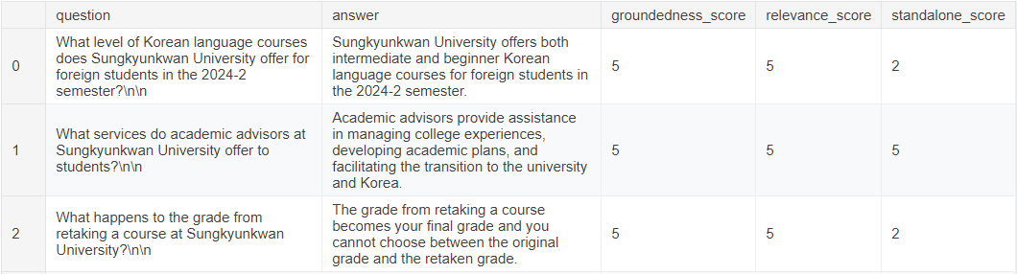
Evaluation Dataset
After applying filtering criteria:
< 3!
< 3!
Notes:
First, in Indexing part, A problem with using Webbaseloader() to scrap data from web is that the structured data are not handled properly.
It naively turns text from tabular data into plain text, losing its structure.

Slide 30
Front-end
5
Build our chatbot UI
Notes:
We started frontend development last week. Let me tell you about progress.

Slide 31



Front-end
React - Reusable Component, Virtual DOM
TypeScript - Type safety
MUI(Material UI) - Compatibility with react, Many Components & Icons
Notes:
We chose React and TypeScript for our web development due to their efficiency and strong type safety.
For UI components, we opted for Material UI, as it’s highly compatible with React and offers a wide range of components and icons.

Slide 32
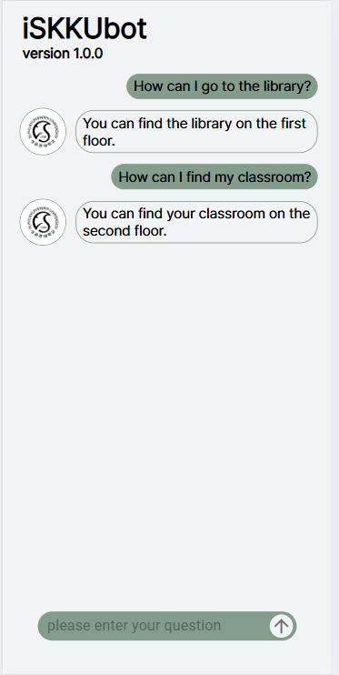
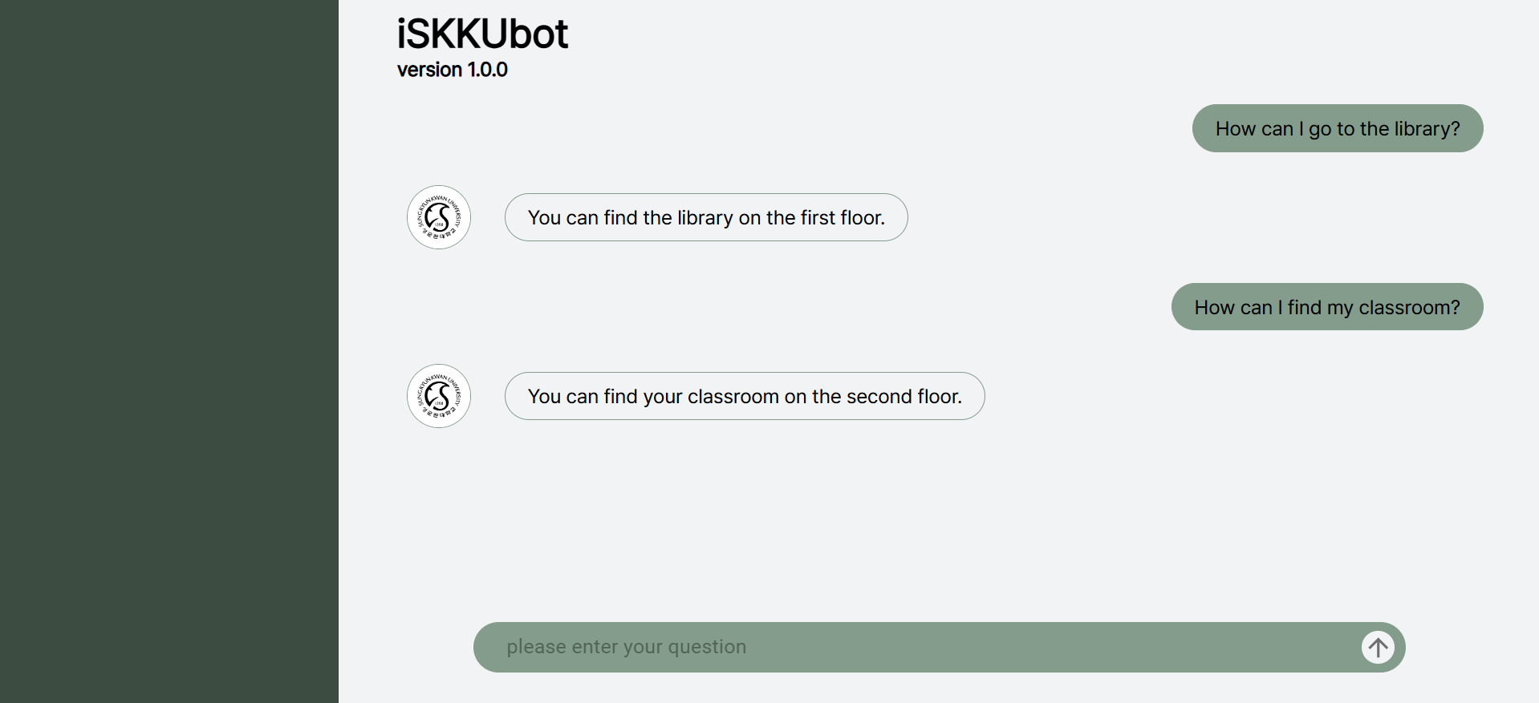
Front-end
ISKKUbot PC ver.
ISKKUbot Mobile ver.
Notes:
This is the current chatbot screen under development.
The chat bubble and message input field component are complete, while the sidebar and header are still in progress. These components are designed to resize according to the device's screen size, allowing users to interact comfortably with the chatbot on various devices.

Slide 33
Next Tasks
Finish front-end and back-end implementation.
Implement code for evaluation.
Evaluate our model with eval dataset.
Develop automatic database update function.
Notes:
we are planning to do this five steps after this class.
first, we are going to implement webpage
second, we are going to select embedding model and metric and refactor code for update data
third, we are going to make bilingual model api
fourth, we are going to test with sample data
finally, we will implement backend api.

Slide 34
References
https://velog.io/@hyerin0930/React-%EB%B0%98%EC%9D%91%ED%98%95-%EA%B5%AC%ED%98%84%ED%95%98%EA%B8%B0-with-react-responsive
https://enne.tistory.com/6
https://medium.com/@mauryaanoop3/the-indispensable-reranker-a-deep-dive-into-optimizing-retrieval-in-retrieval-augmented-generation-a12793ee393c
https://www.pinecone.io/learn/series/rag/rerankers/
https://huggingface.co/learn/cookbook/rag_evaluation
Notes:
And this is our references.

Slide 35
Thank you!
Do you have any questions?

